Slide 1




Sorting and Searching Algorithms
Sorting, Searching, Shuffling
Sorting
Searching
SoftUni Team
Technical Trainers
Software University
http://softuni.bg

Slide 2




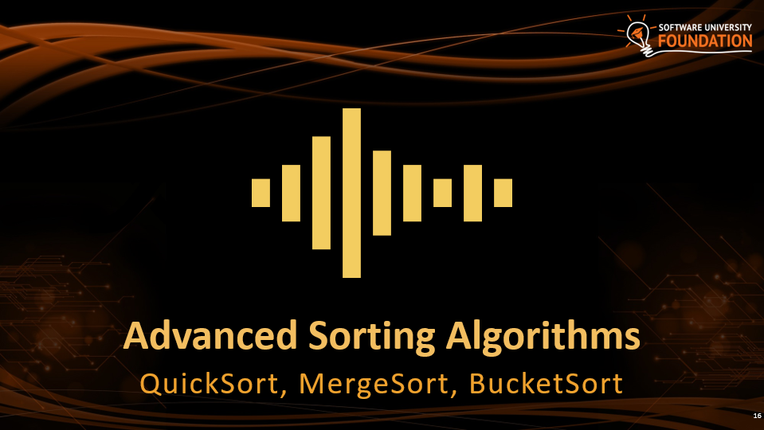


Table of Contents

Slide 3
Have a Question?
sli.do #DsAlgo

Slide 4

Simple Sorting Algorithms
BubbleSort, InsertionSort, SelectSort

Slide 5
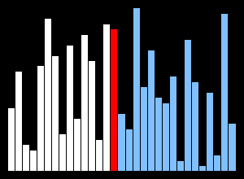
What is a Sorting Algorithm?
Sorting algorithm
An algorithm that rearranges elements in a list
In non-decreasing order
Elements must be comparable
More formally
The input is a sequence / list of elements
The output is an rearrangement / permutation of elements
In non-decreasing order

Slide 6

Sorting – Example
Efficient sorting algorithms are important for
Producing human-readable output
Canonicalizing data – making data uniquely arranged
In conjunction with other algorithms, like binary searching
Example of sorting:
Unsorted list
sorting
Sorted list
10 | 3 | 7 | 3 | 4
3 | 3 | 4 | 7 | 10

Slide 7
Sorting Algorithms: Classification
Sorting algorithms are often classified by
Computational complexity and memory usage
Worst, average and best case behavior
Recursive / non-recursive
Stability – stable / unstable
Comparison-based sort / non-comparison based
Sorting method: insertion, exchange (bubble sort and quicksort), selection (heapsort), merging, serial / parallel, etc.

Slide 8
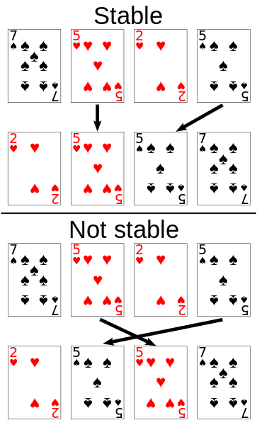
Stability of Sorting
Stable sorting algorithms
Maintain the order of equal elements
If two items compare as equal, their relative order is preserved
Unstable sorting algorithms
Rearrange the equal elements in unpredictable order
Often different elements have same key used for equality comparing

Slide 9
Sorting Helper Methods
static void Swap<T>(T[] collection, int from, int to)
{
//TODO: Swap the elements
}
static bool Less(IComparable first, IComparable second)
{
return first.CompareTo(second) < 0;
}

Slide 10
Selection Sort
Selection sort – simple, but inefficient algorithm (visualize)
Swap the first with the min element on the right, then the second, etc.
Memory: O(1)
Stable: No
Method: Selection

Slide 11
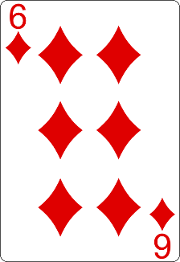
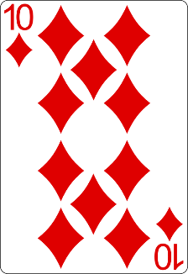
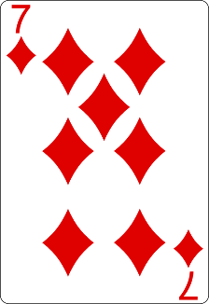
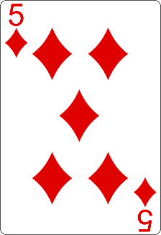
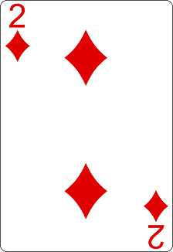
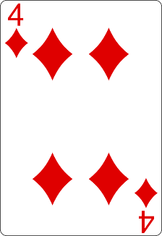
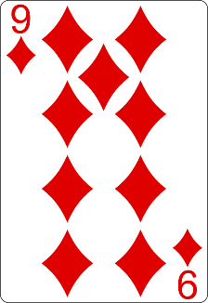
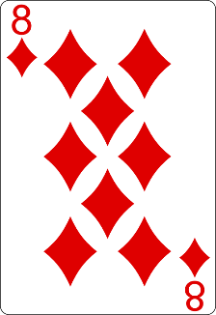
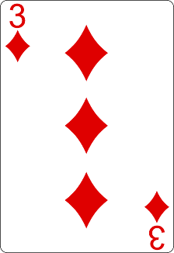
Selection Sort Visualization
Index
Min

Slide 12
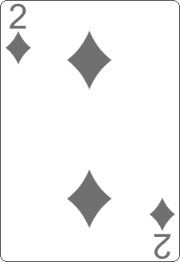
Selection Sort Visualization
Index
Min

Slide 13
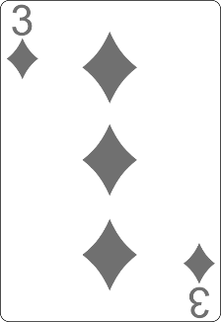
Selection Sort Visualization
Index
Min

Slide 14
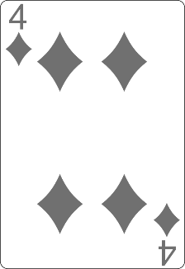
Selection Sort Visualization
Min
Index

Slide 15
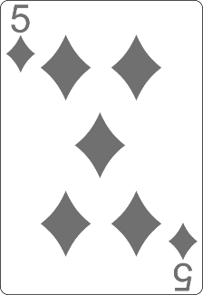
Selection Sort Visualization
Min
Index

Slide 16
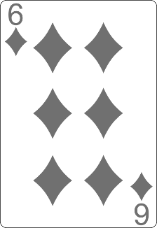
Selection Sort Visualization
Min
Index

Slide 17
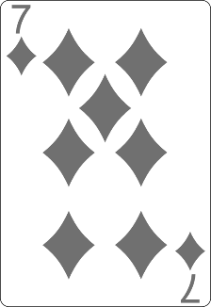
Selection Sort Visualization
Index
Min

Slide 18
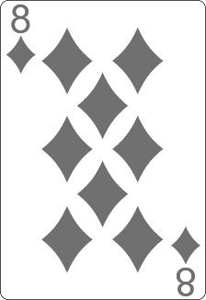
Selection Sort Visualization
Min
Index

Slide 19
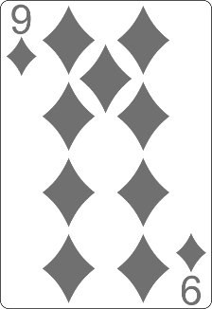
Selection Sort Visualization
Min
Index

Slide 20
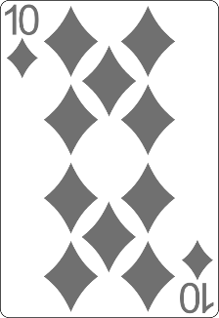
Selection Sort Visualization

Slide 21
Selection Sort Visualization

Slide 22
Selection Sort: Why Unstable?
Why the "selection sort" is unstable?
Swaps the first element with the min element on the right
Swaps the second element with the min element on the right
…
During the swaps equal elements can jump over each other
left
min
swap
equal elements
changed order
3♥ | 5♠ | 3♦ | 4♥ | 2♣
3♥ | 5♠ | 3♦ | 4♥ | 2♣
2♣ | 5♠ | 3♦ | 4♥ | 3♥

Slide 23
Selection Sort Code
for (int index = 0; index < collection.Length; index++)
{
int min = index;
for (int curr = index + 1; curr < collection.Length; curr++)
{
if (Less(collection[curr], collection[min]))
{
min = curr;
}
}
Swap(collection, index, min);
}

Slide 24
Comparison of Sorting Algorithms
Name | Best | Average | Worst | Memory | Stable | Method
SelectionSort | n² | n² | n² | 1 | No | Selection

Slide 25
Bubble Sort
Bubble sort – simple, but inefficient algorithm (visualize)
Swaps to neighbor elements when not in order until sorted
Memory: O(1)
Stable: Yes
Method: Exchanging

Slide 26
Bubble Sort Visualization
i
j

Slide 27
Bubble Sort Visualization
i
j

Slide 28
Bubble Sort Visualization
i
j

Slide 29
Bubble Sort Visualization
i
j

Slide 30
Bubble Sort Visualization
i
j

Slide 31
Bubble Sort Visualization
i
j

Slide 32
Bubble Sort Visualization
i
j

Slide 33
Bubble Sort Visualization
i
j

Slide 34
Bubble Sort Visualization
i
j

Slide 35
Bubble Sort Visualization
i
j

Slide 36
Bubble Sort Visualization
i
j

Slide 37
Bubble Sort Visualization
i
j

Slide 38
Bubble Sort Visualization
i
j

Slide 39
Bubble Sort Visualization
i
j

Slide 40
Bubble Sort Visualization
i
j

Slide 41
Bubble Sort Visualization
i
j

Slide 42
Bubble Sort Visualization
i
j

Slide 43
Bubble Sort Visualization
i
j

Slide 44
Bubble Sort Visualization
i
j

Slide 45
Bubble Sort Visualization
i
j

Slide 46
Bubble Sort Visualization
i
j

Slide 47
Bubble Sort Visualization
i
j

Slide 48
Bubble Sort Visualization
i
j

Slide 49
Bubble Sort Visualization
i
j

Slide 50
Bubble Sort Visualization
i
j

Slide 51
Bubble Sort Visualization
i
j

Slide 52
Bubble Sort Visualization
i
j

Slide 53
Bubble Sort Visualization
i
j

Slide 54
Bubble Sort Visualization
i
j

Slide 55
Bubble Sort Visualization
i
j

Slide 56
Bubble Sort Visualization
i
j

Slide 57
Bubble Sort Visualization
i
j

Slide 58
Bubble Sort Visualization
i
j

Slide 59
Bubble Sort Visualization
i
j

Slide 60
Bubble Sort Visualization
i
j

Slide 61
Bubble Sort Visualization

Slide 62
Comparison of Sorting Algorithms
Name | Best | Average | Worst | Memory | Stable | Method
SelectionSort | n² | n² | n² | 1 | No | Selection
BubbleSort | n | n² | n² | 1 | Yes | Exchanging

Slide 63
Insertion Sort
Insertion sort – simple, but inefficient algorithm (visualize)
Move the first unsorted element left to its place
Memory: O(1)
Stable: Yes
Method: Insertion

Slide 64
Comparison of Sorting Algorithms
Name | Best | Average | Worst | Memory | Stable | Method
SelectionSort | n² | n² | n² | 1 | No | Selection
BubbleSort | n | n² | n² | 1 | Yes | Exchanging
InsertionSort | n | n² | n² | 1 | Yes | Insertion

Slide 65

Shuffling
Fisher-Yates Shuffle

Slide 66
Shuffling
Shuffling == randomizing the order of items in a collection
Generate a random permutation
The generation of random numbers is too important to be left to chance. —Robert R. Coveyou

Slide 67
Fisher–Yates Shuffle Algorithm
public static void Shuffle<T>(T[] source)
{
Random rnd = new Random();
for (int i = 0; i < source.Length; i++)
{
// Exchange array[i] with random element in array[i … n-1]
int r = i + rnd.Next(0, source.Length - i);
T temp = source[i];
source[i] = source[r];
source[r] = temp;
}
}
Shuffle algorithms: visualization

Slide 68


Advanced Sorting Algorithms
QuickSort, MergeSort, BucketSort

Slide 69
Merge Sort
Merge sort is efficient sorting algorithm (visualize)
Divide the list into sub-lists (typically 2 sub-lists)
Sort each sub-list (recursively call merge-sort)
Merge the sorted sub-lists into a single list
Best, average and worst case: O(n*log(n))
Memory:
Typically O(n)
With in-place merge can be O(1)
Highly parallelizable on multiple cores / machines → up to O(log(n))
Stable: Yes
Method: Merging

Slide 70
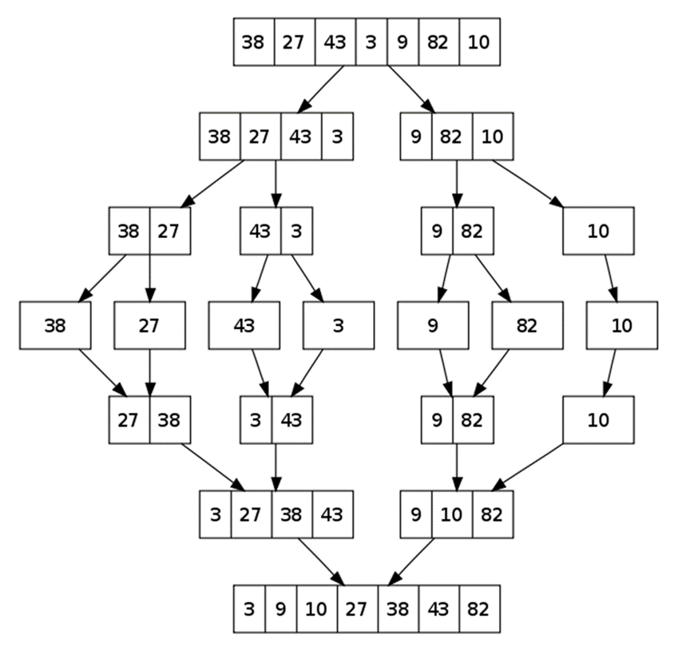
Merge Sort: Hot It Works?

Slide 71
QuickSort
QuickSort – efficient sorting algorithm (visualize)
Choose a pivot; move smaller elements left & larger right; sort left & right
Best & average case: O(n*log(n)); Worst: O(n²)
Memory: O(log(n)) stack space (for recursion)
Stable: Depends
Method: Partitioning

Slide 72
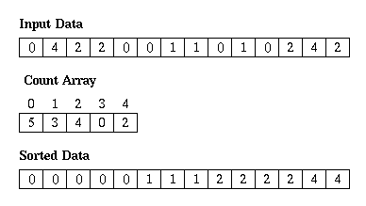
Counting Sort
Counting sort is a very efficient sorting algorithm (visualize)
Sorts small integers by counting their occurrences
Not a comparison-based sort
Best, average and worst case: O(n + k)
k is the range of numbers to be sorted
E.g. [-1000 ... 1000] → k = 2001
Memory: O(n + k) Space: O(k)
Stable: Yes
Method: Counting

Slide 73
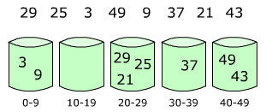
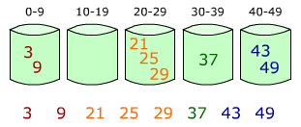
Bucket Sort
Bucket sort partitions an array into a number of buckets
Each bucket is then sorted individually with a different algorithm
Not a comparison-based sort
Average case: O(n + k)
k = the number of buckets
Worst case: O(n * log n)
Stable: Yes (depends on algorithm)
Memory: O(n) – k buckets holding n elements totally

Slide 74
Comparison of Sorting Algorithms
Name | Best | Average | Worst | Memory | Stable | Method
SelectionSort | n² | n² | n² | 1 | No | Selection
BubbleSort | n | n² | n² | 1 | Yes | Exchanging
InsertionSort | n | n² | n² | 1 | Yes | Insertion
QuickSort | n*log(n) | n*log(n) | n² | log(n) | Depends | Partitioning
MergeSort | n*log(n) | n*log(n) | n*log(n) | 1 (or n) | Yes | Merging
HeapSort | n*log(n) | n*log(n) | n*log(n) | 1 | No | Selection
BogoSort | n | n*n! | n*n! | 1 | No | Luck

Slide 75


Searching Algorithms
Linear, Binary and Interpolation

Slide 76

Search Algorithm
Search algorithm == an algorithm for finding an item with specified properties among a collection of items
Different types of searching algorithms
For virtual search spaces
Satisfy specific mathematical equations
Try to exploit partial knowledge about a structure
For sub-structures of a given structure
A graph, a string, a finite group
Search for the min / max of a function, etc.

Slide 77
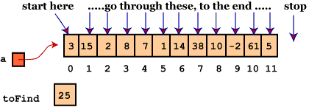
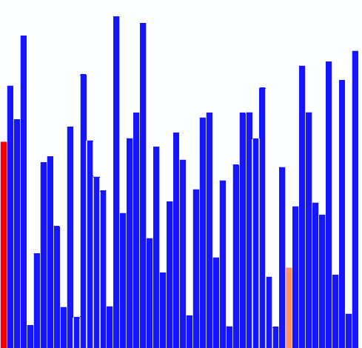
Linear Search
Linear search finds a particular value in a list (visualize)
Checking every one of the elements
One at a time, in sequence
Until the desired one is found
Worst & average performance: O(n)
for each item in the list:
if that item has the desired value,
return the item's location
return nothing

Slide 78
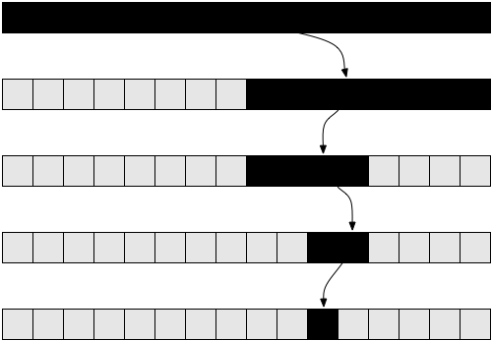
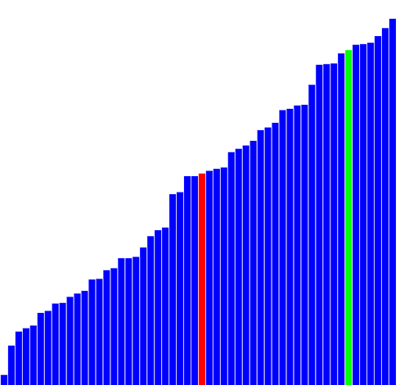
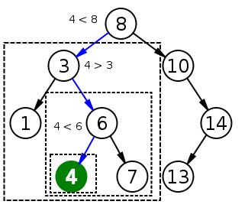
Binary Search
Binary search finds an item within a ordered data structure
At each step, compare the input with the middle element
The algorithm repeats its action to the left or right sub-structure
Average performance: O(log(n))
See the visualization

Slide 79
Binary Search (Recursive)
int BinarySearch(int arr[], int key, int start, int end) {
if (end < start)
return KEY_NOT_FOUND;
else {
int mid = (start + end) / 2;
if (arr[mid] > key)
return BinarySearch(arr, key, start, mid - 1);
else if (arr[mid] < key)
return BinarySearch(arr, key, mid + 1, end);
else
return mid;
}
}

Slide 80
Binary Search (Iterative)
int BinarySearch(int arr[], int key, int start, int end) {
while (end >= start) {
int mid = (start + end) / 2;
if (arr[mid] < key)
start = mid + 1;
else if (arr[mid] > key)
end = mid - 1;
else
return mid;
}
return KEY_NOT_FOUND;
}

Slide 81
Interpolation Search
Interpolation search == an algorithm for searching for a given key in an ordered indexed array
Parallels how humans search through a telephone book
Calculates where in the remaining search space the item might be
Binary search always chooses the middle element
Can we have a better hit, e.g. Angel in the phonebook should be at the start, not at the middle, OK?
Average case: log(log(n)), Worst case: O(n)
http://youtube.com/watch?v=l1ed_bTv7Hw

Slide 82
Interpolation Search – Sample Implementation
int InterpolationSearch(int[] sortedArray, int key) {
int low = 0;
int high = sortedArray.Length - 1;
while (sortedArray[low] <= key && sortedArray[high] >= key) {
int mid = low + ((key - sortedArray[low]) * (high - low))
/ (sortedArray[high] - sortedArray[low]);
if (sortedArray[mid] < key)
low = mid + 1;
else if (sortedArray[mid] > key)
high = mid - 1;
else
return mid;
}
if (sortedArray[low] == key) return low;
else return KEY_NOT_FOUND;
}

Slide 83

Summary
Slow sorting algorithms:
Selection sort, Bubble sort, Insertion sort
Fast sorting algorithms:
Quick sort, Merge sort, etc.
How to choose the most appropriate algorithm?
http://stackoverflow.com/a/1934004
Searching algorithms
Binary Search, Interpolation Search

Slide 84







Sorting and Searching Algorithms
https://softuni.bg/opencourses/algorithms

Slide 85
License
This course (slides, examples, labs, videos, homework, etc.) is licensed under the "Creative Commons Attribution-NonCommercial-ShareAlike 4.0 International" license
Attribution: this work may contain portions from
"Fundamentals of Computer Programming with C#" book by Svetlin Nakov & Co. under CC-BY-SA license
"Data Structures and Algorithms" course by Telerik Academy under CC-BY-NC-SA license

Slide 86





Trainings @ Software University (SoftUni)
Software University – High-Quality Education, Profession and Job for Software Developers
softuni.bg
Software University Foundation
softuni.org
Software University @ Facebook
facebook.com/SoftwareUniversity
Software University Forums
forum.softuni.bg

